Slide 1
The Battle of Neighborhoods

Slide 2
Introduction

Slide 3
Introduction
I am a person living in Hong Kong.
I am living in the Kennedy Town region, where it is very close to the underground station. The region has a balance of the eastern and western culture. It is easily accessible to the central downtown, but far enough to enjoy a quiet and relaxed environment. Recently, I have been invited by my boss to work in Toronto. The package is a nice deal and I decided to accept it. I am very excited, and at the same time very busy at the preparation work. I am looking for an apartment in Toronto which has a similar ambience compared to my current living environment. The question is, which Neighborhood should I look for?

Slide 4
Business Problem

Slide 5
Business Problem
To find a neighborhood in Toronto that exhibits the closest characteristics compared to my current home: Kennedy town. The steps could include:
Getting the characteristics of Kennedy Town
Matching the characteristics of Kennedy Town to a neighborhood (or a few neighborhoods) in Toronto for consideration

Slide 6
Data

Slide 7
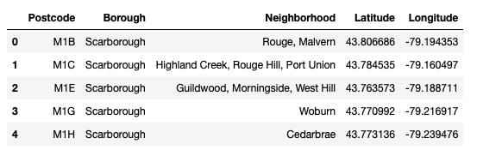
Data – Toronto Data
We will use the Toronto Data we have prepared in week 3.

Slide 8
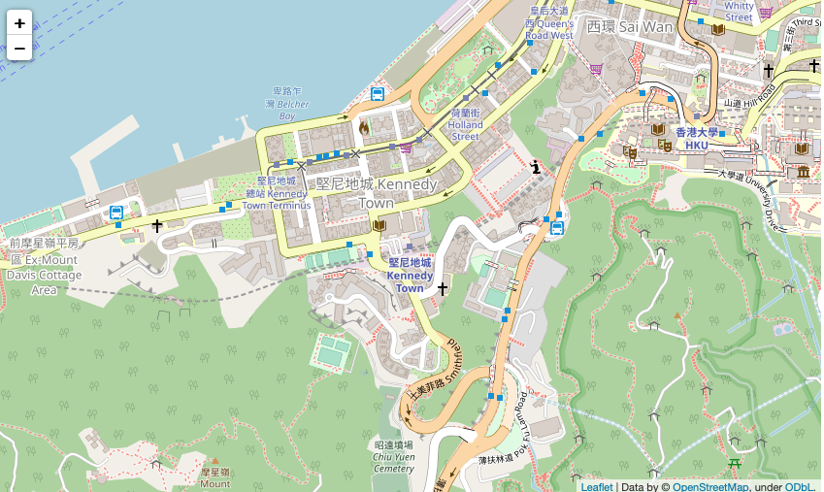
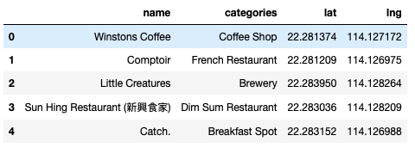
Data – Kenney Town Data
We will use foursquare to get the Kennedy Town data.

Slide 9
Methodology

Slide 10
Methodology
Majorly relied on Foursquare API to retrieve all venues of each neighborhoods, then group by each neighborhoods and to count how many venues before filter top 10 most common venue types of each neighborhoods.
We will process the Kennedy Town data in the same way, and see which cluster does Kennedy Town falls in. The Neighborhoods in the same cluster should demonstrate similar characteristics as Kennedy Town

Slide 11
Analysis

Slide 12
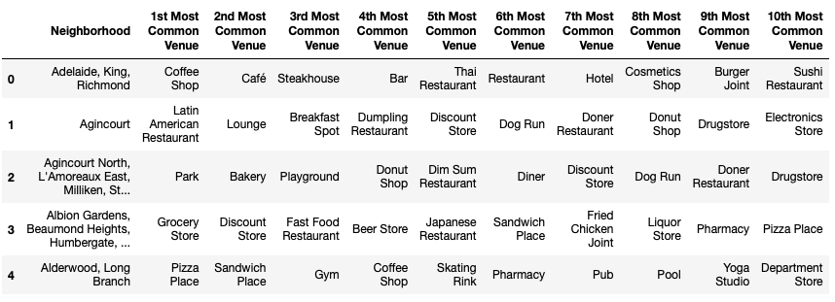
Analysis
A snapshot of Toronto’s Neighborhood’s most common venues

Slide 13
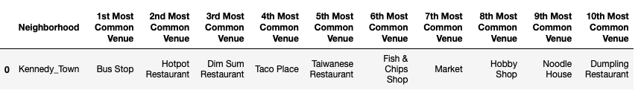
Analysis
A snapshot of Kennedy Town’s Neighborhood’s most common venues.
It seems that Kennedy Town is filled with a lot of restaurants!

Slide 14
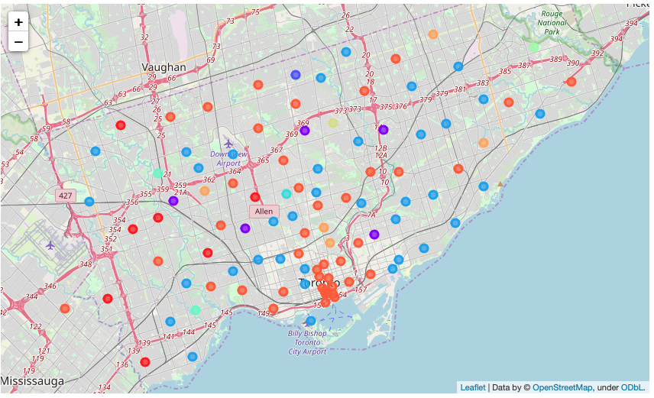
Analysis
We used k-means algorithm to divide all neighborhoods in Toronto into 10 clusters.

Slide 15
Results

Slide 16
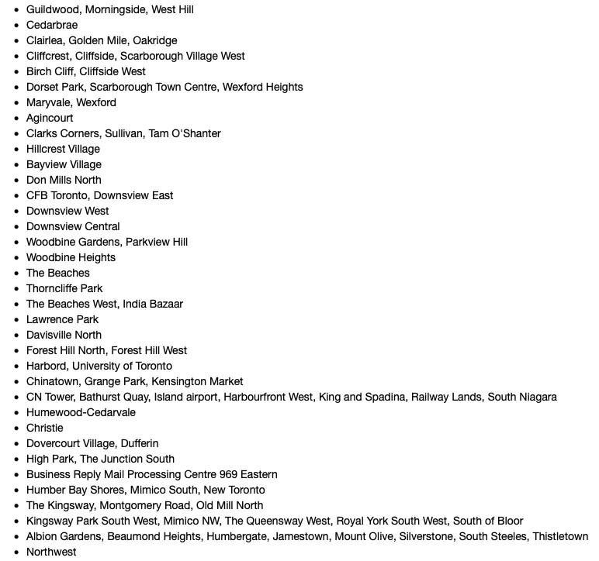
Results
Kennedy Town was predicted by the k-means algorithm to be in cluster 3.
Let’s take a look at the neighborhoods in Toronto cluster 3:

Slide 17
Discussion

Slide 18
Discussion
Taking a look at the most common places in Cluster 3 neighborhoods, we see that most of them really contains a lot of restaurants: e.g. Bakery, Hakka Restaurant, Pizza Place, Caribbean Restaurant, Thai Restaurant etc.
Therefore, from this perspective, the algorithm really works as expected.

Slide 19
Conclusion

Slide 20
Conclusion
Most of the restaurants are concentrated in the Cluster 3 Neighborhoods in Toronto.
I will start searching my new home in those Cluster 3 neighborhoods.

